Slide 1
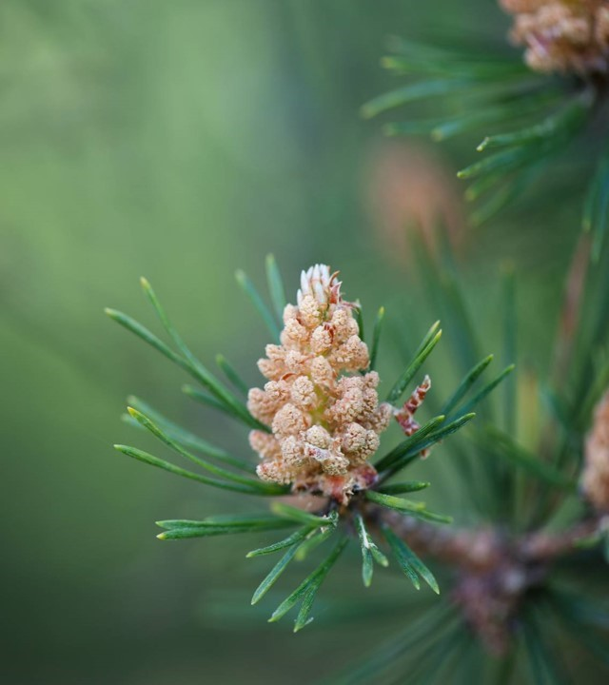
GES 3050 – Cartography Final project ideas Group1: - Vanessa Vedral - Meghan Boniecki - Chase Ingersoll - Katie Dickamore

Slide 2
Concept options overview
Concept 1: De-Reforestation
Global environmental story showing forest loss & projections based on human choices
Scrollable timeline, user-driven scenario options
Data-driven environmental storytelling
Concept 2: Catography
Creative geographic exploration of wild cat species — tracing ancient ranges, current habitats, and possible futures
Timeline story of species movement, endangerment, and possible survival/restoration scenarios
Science and conservation combined

Slide 3
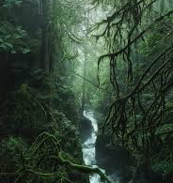
De/reforestation
Deforestation Then, Now, and Possible Futures
An interactive scroll-driven map experience exploring the story of global deforestation, showing change over time (historical), and letting users see how different future choices might impact forests & carbon storage.

Slide 4
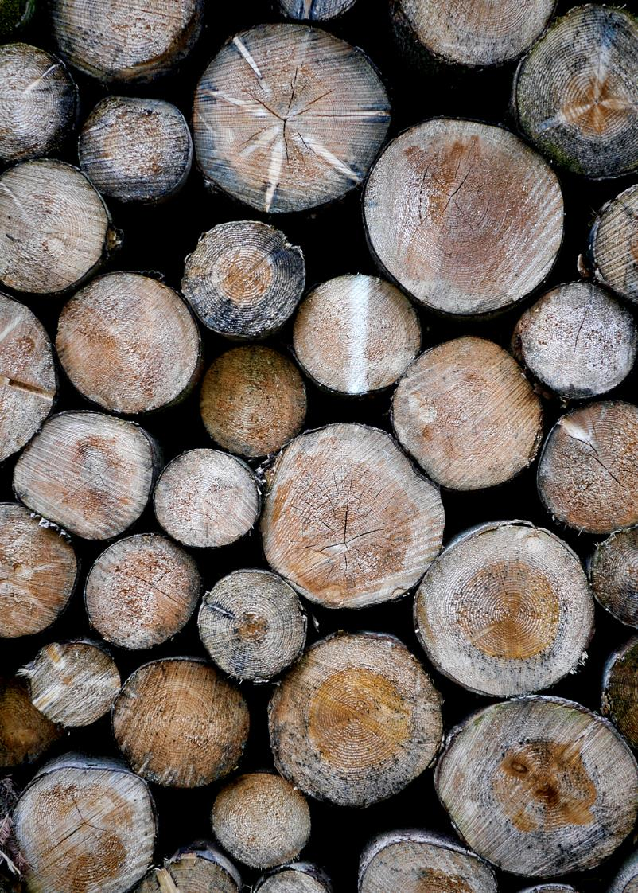
De/ReForestation Data and Tools:
Potential Data Sources:
Global Forest Watch
Globil PANDA Restoration Potential
WRI Carbon Storage Estimates
Socio-economic overlays from World Bank and FAO
Tools:
Mapbox Studio
Scrollama.js
HTML/CSS
GitHub Pages

Slide 5
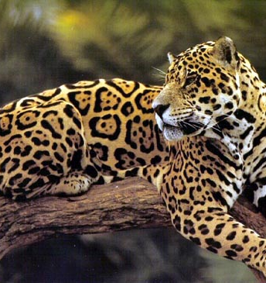
Catography
Mapping the Past, Present & Future of the World’s Cats
A spatial story of wild cats across the globe — tracing their ancient ranges, their shrinking habitats, their perilous futures... and what might happen if we protect them (or don’t).

Slide 6
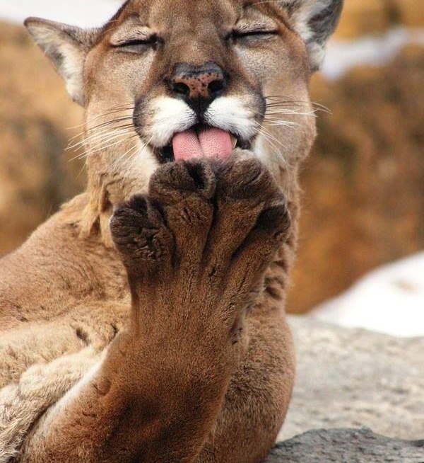
De/ReForestation Data and Tools:
Potential Data Sources:
IUCN Red List Range Maps
Panthera Wild Cat Conservation
WWF Species Data
Smithsonian Big Cats Map
Tools:
Mapbox Studio
Scrollama.js
HTML/CSS
GitHub Pages

Slide 7
Collaborate – Divide - Achieve
Task Name | Major Contributors | Additional Contributors | Relevant Outcomes
Concept Development
Data preparation and Integration
Visualization 1
Visualization 2
Visualization 3
Visualization 4
Website Development
Report Writing

Slide 8
The End

